Slide 1

Global Power Plant Database
- Analysis
Aarav Vishesh Dewangan
Bruna Medeiros
Halleluya Mengesha
Hritik Jhaveri
Veera Anand
Dec 2024

Slide 2

Agenda
Executive Summary
Business Use Cases
Methodology
Data Analysis
Visualizations
Recommendations
Lessons Learned

Slide 3
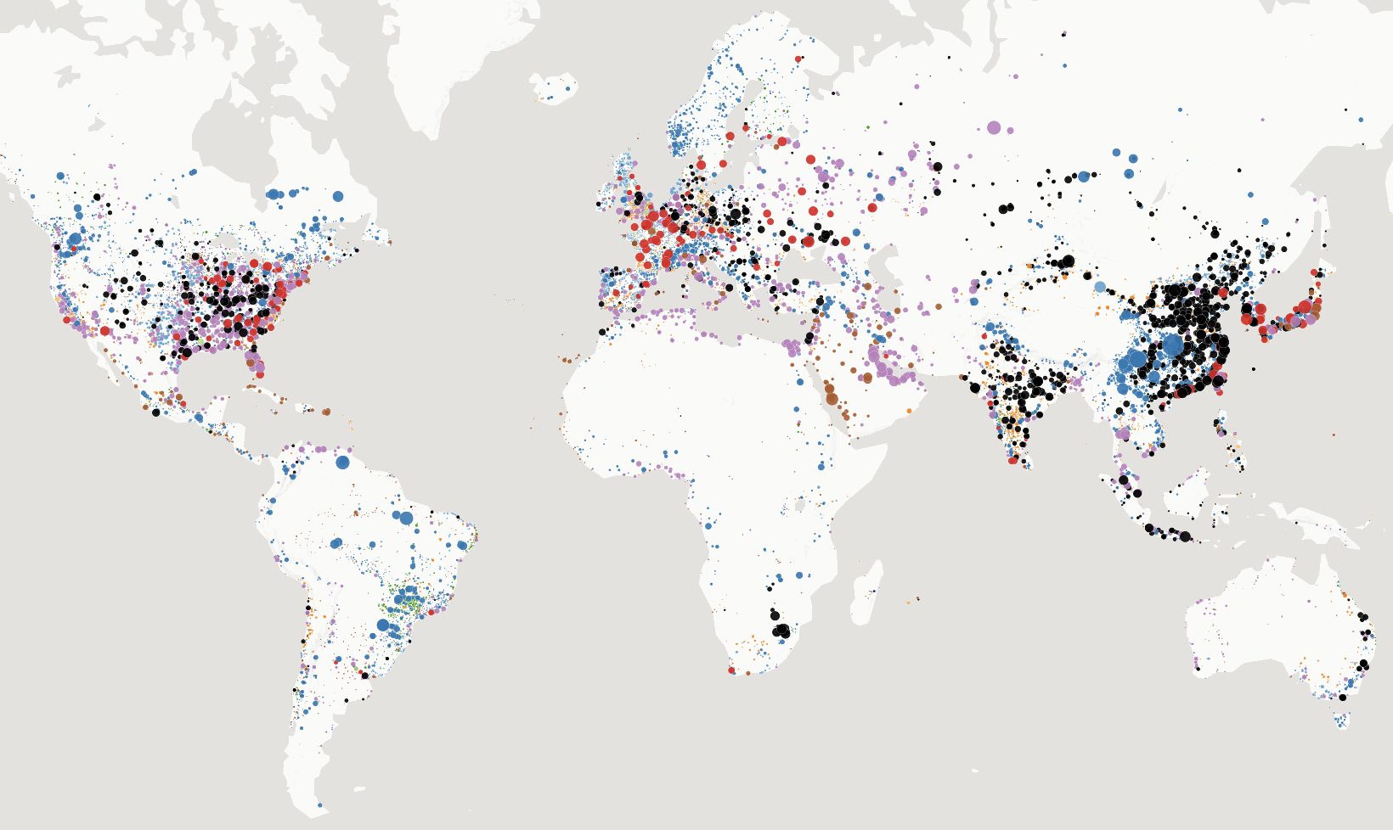
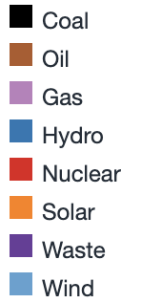
Data Overview
34,937 records of 164 countries.
72% of the world’s electricity generation capacity
Each record contains:
Power plant details (2013 to 2019):
geolocations
energy source
plant capacity
yearly actual and estimated energy generation
ownership
Data Quality:
> 90% of plants in the US reported energy generation data.
< 50% of plants for other countries reported their energy generation data
Power Plants by Capacity (MW) and Fuel Type
Data Source: Global Power Plant Database
Notes:
193,976 electricity generation records after normalization
energy source : thermal or renewable energy

Slide 4
Executive Summary
Problem Statement:
Energy stakeholders lack actionable insights to identify renewable energy investment opportunities, ensure emission compliance, and quantify the economic contributions of power plants.
Goal:
To provide data-driven insights that support renewable energy investment, emission compliance, and economic impact analysis for informed decision-making by energy stakeholders.
Observation: The global energy sector is undergoing a significant transformation: increasing focus on renewable energy sources and sustainable practices. | Key challenges: Uneven adoption of renewables across regions Compliance with emission standards Economic impact on economies.

Slide 5

Business Use Cases
Identifying Renewable Energy Hotspots:
Identify regions leading in adding renewable energy sources over the past few years
Goal: Help policymakers identify thriving regions to replicate successful strategies in other areas and allocate resources more effectively.
Emission Compliance Monitoring:
Identify CO₂ emissions for each energy fuel type
Goal: Identify energy fuel types that contribute the most to CO₂ emissions to strategize on transitioning to cleaner, low-emission alternatives.
Regional Economic Impact by Fuel Type:
Analyze the economic contribution of power plants by fuel type in terms of employment.
Goal: Identify the fuel types generating the most employment

Slide 6







Data Processing Tools
Data Cleaning Python MS-Excel Data Modeling and Analysis MySQL MySQL Workbench Google Cloud | III. Data Visualization Tableau IV. Reporting and Recommendations MS-PowerPoint

Slide 7





Extract | Transform | Load
Collect raw data: Primary Dataset Global Power Plant Database Secondary Datasets: Employment data US Bureau Labor Statistics CO2 Emissions data Fifth Assessment Report - IPCC | Clean Data: Trim white spaces Remove missing values Remove duplicates and non-ASCII data Normalization: Transform to 2NF Transform to 3NF → Removal of partial and transitive dependency | 3. Export Tables to separate CSV files for each table | Load Google Cloud Database with data
Notes:
Data was initially in First Normal Form (1NF) :
Ensured atomic values
Ensure no repeating groups
Mission value dropped for relevant columns and tables

Slide 8
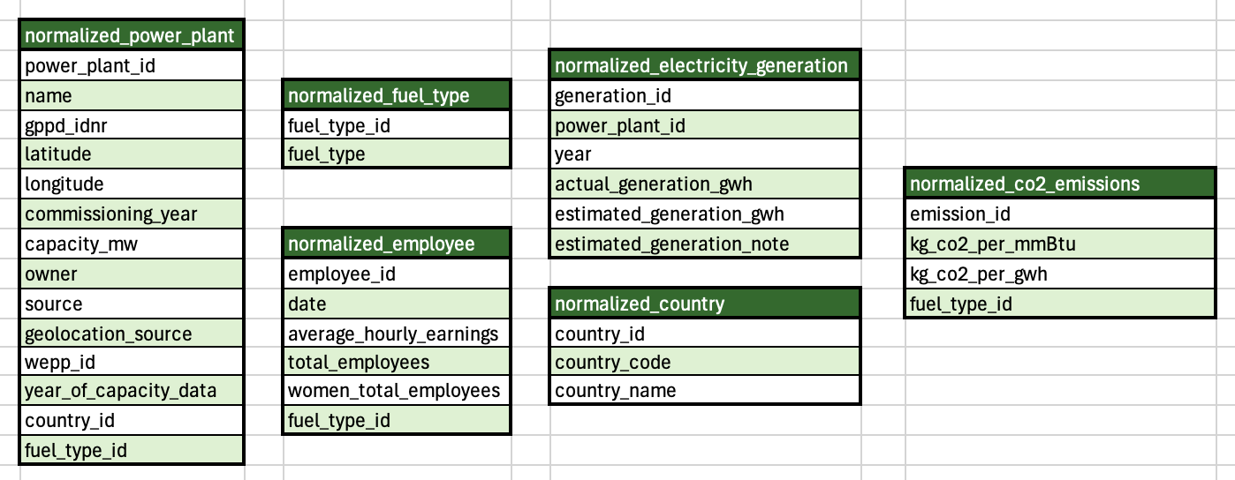
Normalization: Concept Model
Step 1: Data was initially in First Normal Form (1NF) :
Ensured atomic values
Ensure no repeating groups
Step 2: Transformation to Second Normal Form (2NF) :
Removal of partial functional dependencies
Step 3: Transformation to Third Normal Form (3NF) :
Removal of transitive functional dependencies
Notes:
Data was initially in First Normal Form (1NF) :
Ensured atomic values
Ensure no repeating groups
Mission value dropped for relevant columns and tables

Slide 9
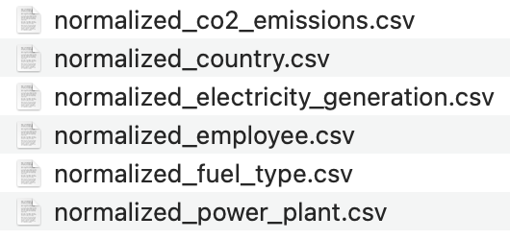
Data Transformation
Step 1: Load Original Datasets into Python
Load data in raw form
Step 2: Create Separate Data Frames for Each Normalized Tables
Select columns from relevant datasets
Ensured correct data types
Cleaned the data by removing missing values, duplicates and non-ASCII data.
Step 3: Export data frames into separate .CSV files:
Notes:
Data was initially in First Normal Form (1NF) :
Ensured atomic values
Ensure no repeating groups
Mission value dropped for relevant columns and tables

Slide 10

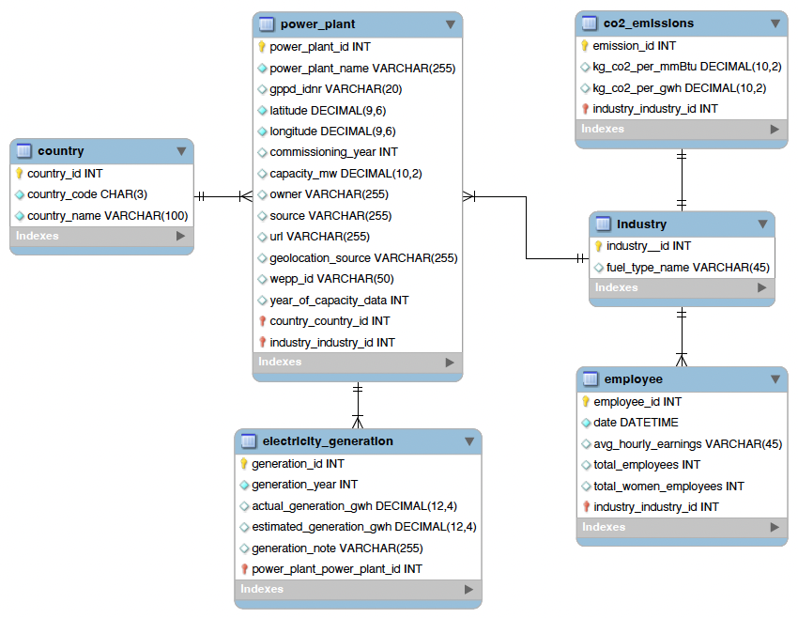
Relational Modeling: EER Diagram
Created tables and columns on MySQL Workbench
Established Primary Keys and Foreign Key Constraints
Create Relationships between tables
Forward Engineered to generate table creation code (Data Definition Language)
Final Output: Enhanced Entity Relationship (EER) Diagram

Slide 11
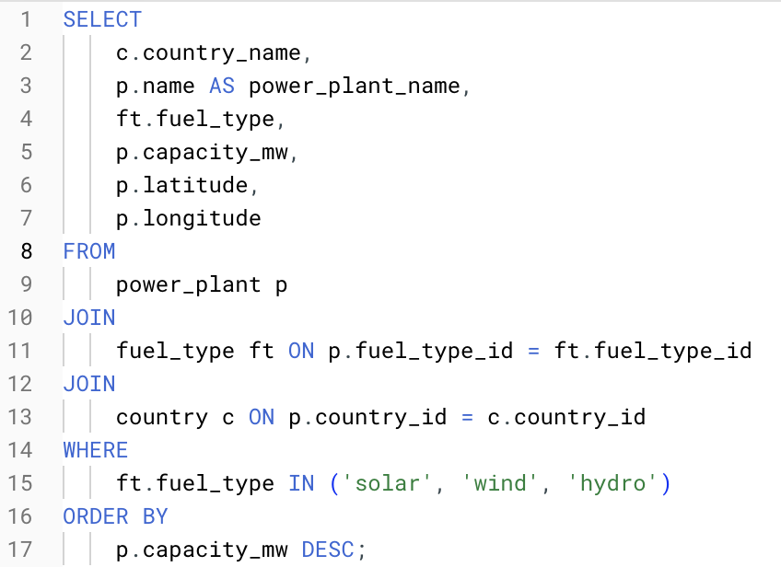
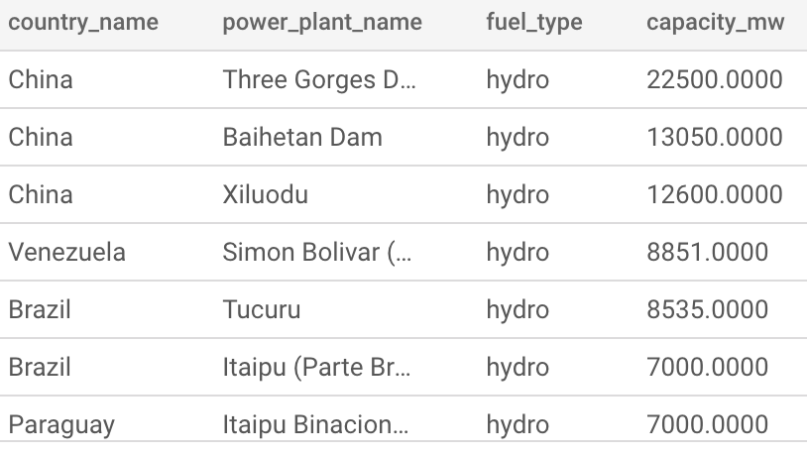
SQL Query 1:
Identifying Renewable Energy Hotspots
Help policymakers identify thriving regions to replicate successful strategies in other areas and allocate resources more effectively.
Code: | Output:
Notes:
# Identifying Renewable Energy Hotspots
SELECT
c.country_name,
p.name AS power_plant_name,
ft.fuel_type,
p.capacity_mw,
p.latitude,
p.longitude
FROM
power_plant p
JOIN
fuel_type ft ON p.fuel_type_id = ft.fuel_type_id
JOIN
country c ON p.country_id = c.country_id
WHERE
ft.fuel_type IN ('solar', 'wind', 'hydro')
ORDER BY
p.capacity_mw DESC;

Slide 12
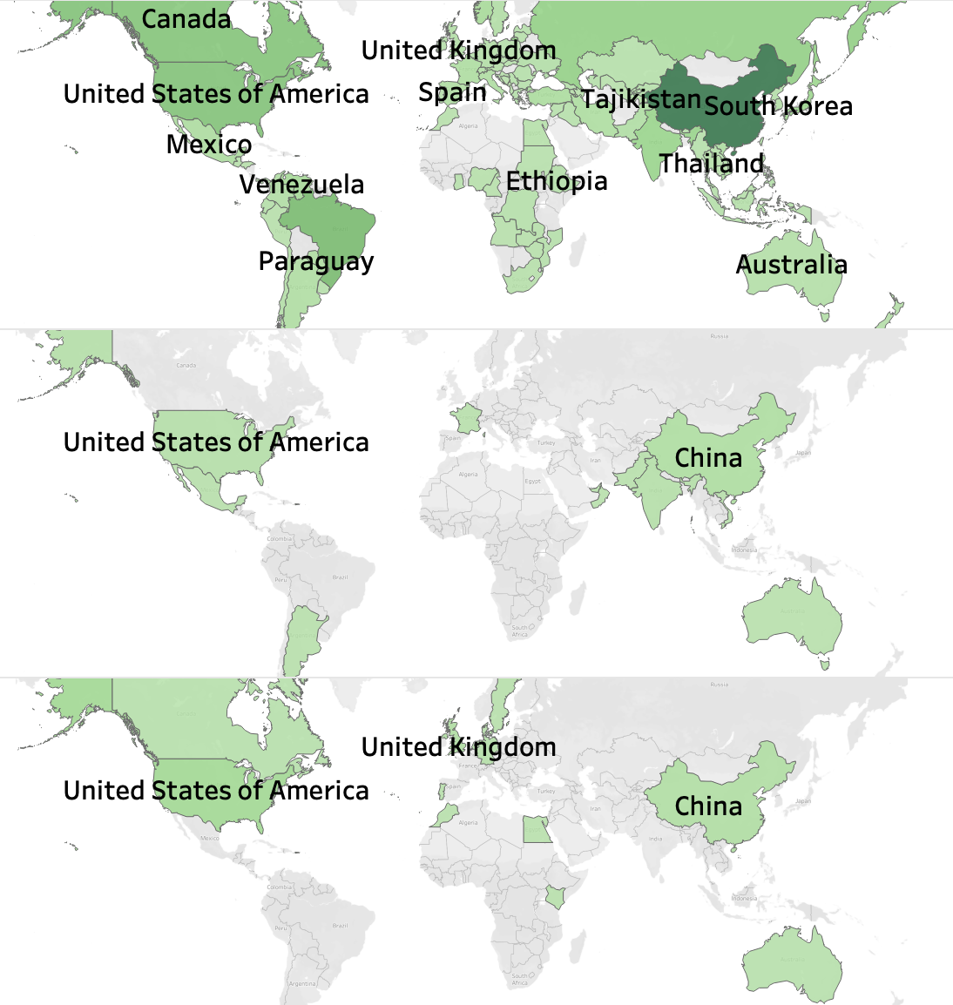
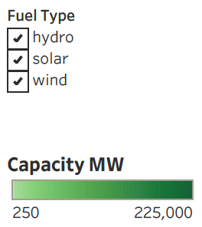
Report Query 1:
Identifying Renewable Energy Hotspots
Global Renewable Energy Capacity by Country and Energy Fuel Type
Fuel Type
Top 3 Hotspot Countries per Energy Source:
Hydro: China, Venezuela and Brazil
Solar: China, India, and United States
Wind: China, United Kingdom and United States
Key:
Highlighted countries have renewable energy capacities ranging from 200 - 225,000 MW
Labeled countries exceed energy capacity of 3,000 Mw
Hydro
Solar
India
Wind

Slide 13
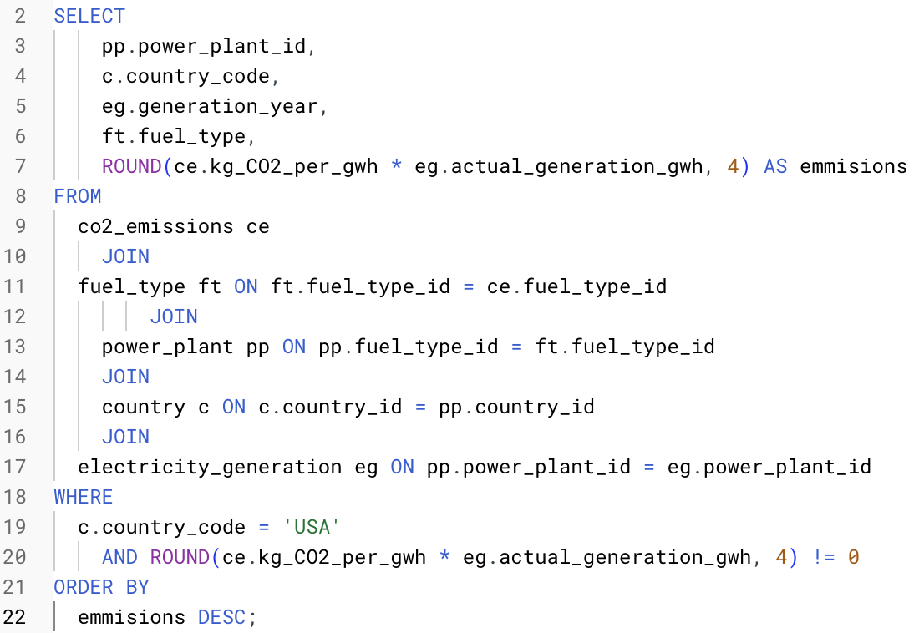
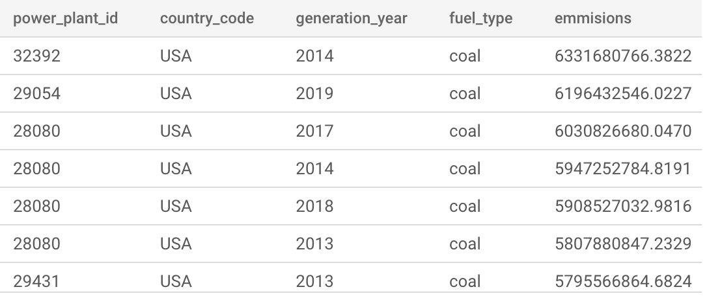
SQL Query 2:
Emissions Compliance Monitoring
Identify energy fuel types that contribute the most to CO₂ emissions to strategize on transitioning from high-emission fuels to cleaner, low-emission alternatives.
Code: | Output:
Notes:
# CO2 Emissions trend
SELECT
pp.power_plant_id,
c.country_code,
eg.generation_year,
ft.fuel_type,
ROUND(ce.kg_CO2_per_gwh * eg.actual_generation_gwh, 4) AS emmisions
FROM
co2_emissions ce
JOIN
fuel_type ft ON ft.fuel_type_id = ce.fuel_type_id
JOIN
power_plant pp ON pp.fuel_type_id = ft.fuel_type_id
JOIN
country c ON c.country_id = pp.country_id
JOIN
electricity_generation eg ON pp.power_plant_id = eg.power_plant_id
WHERE
c.country_code = 'USA'
AND ROUND(ce.kg_CO2_per_gwh * eg.actual_generation_gwh, 4) != 0
ORDER BY
emmisions DESC;

Slide 14
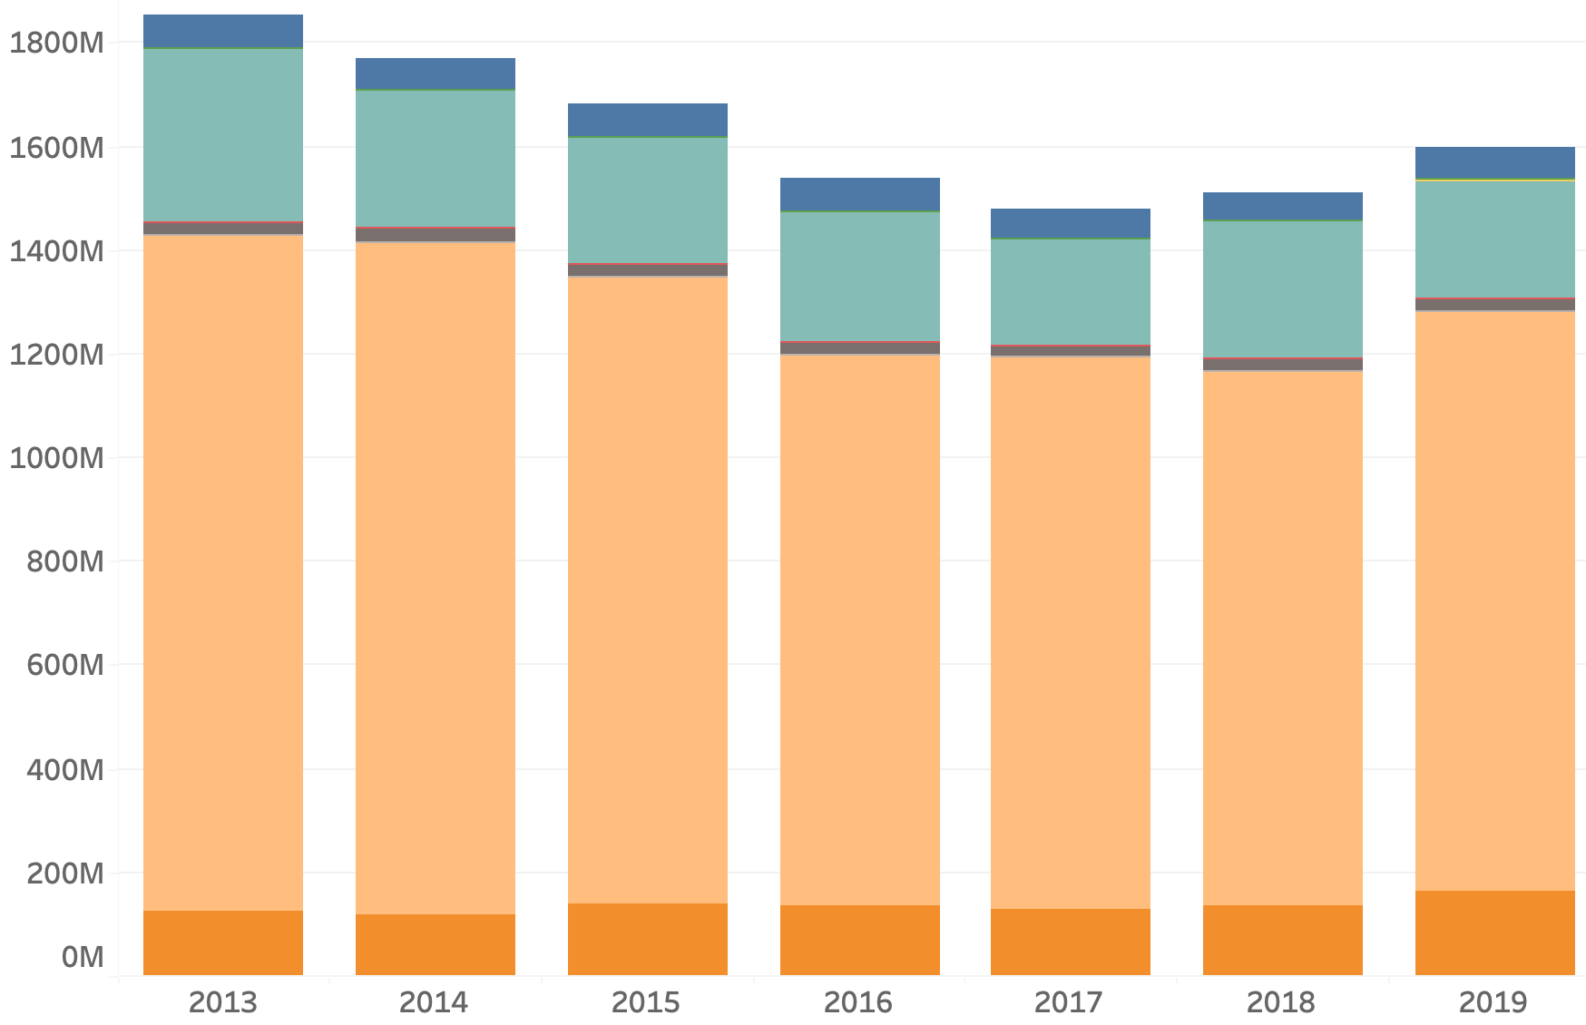
Report Query 2:
Emissions Compliance Monitoring
CO₂ Emissions per Energy Fuel Types
Breakdown of CO₂ emissions per fuel type.
Insights:
Petcoke and Coal remain the largest contributors to emissions.
Overall decrease in emissions throughout the years.
Average Emissions (kg CO2)

Slide 15
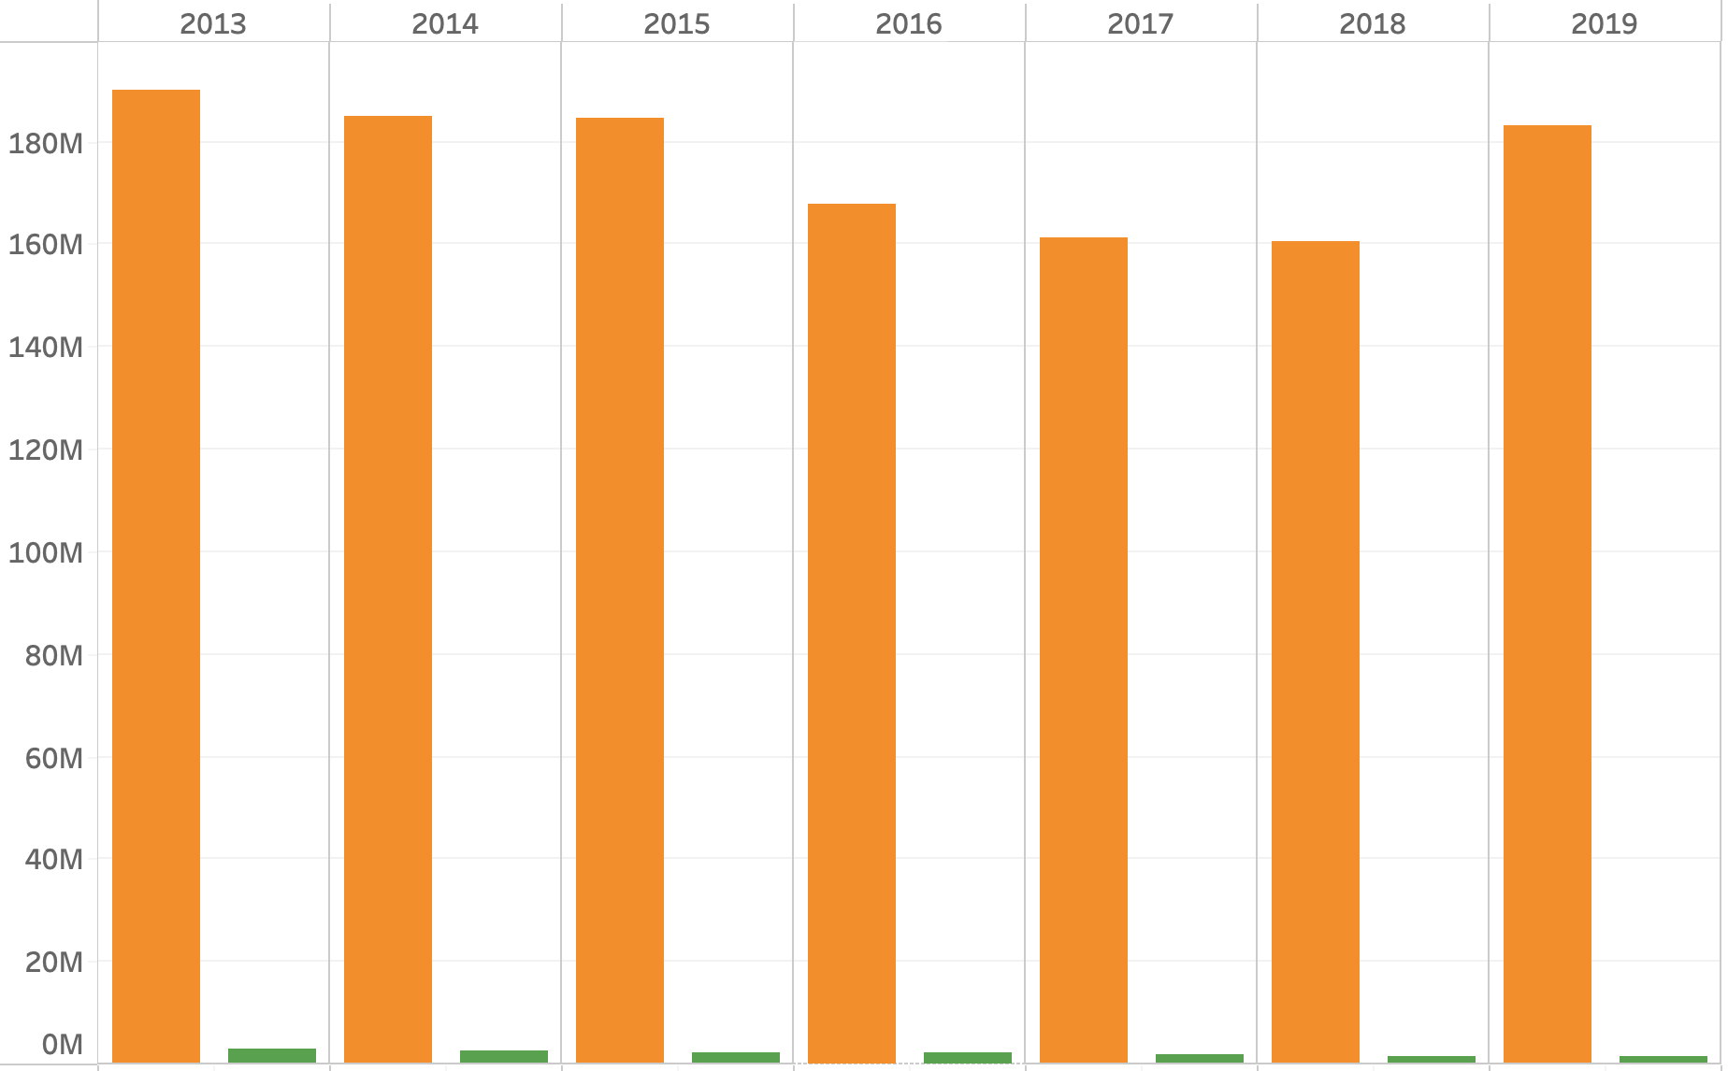
Report Query 2:
Emissions Compliance Monitoring
Renewable Vs Non-Renewable - CO₂ Emissions
Breakdown of CO₂ emissions of renewable vs. non-renewables.
Insights:
Stark contrast between renewable and non-renewable CO2 emissions.
Decrease between non-renewables from 2016-2018 but sharp increase in 2019.
Average Emissions (kg CO2)

Slide 16
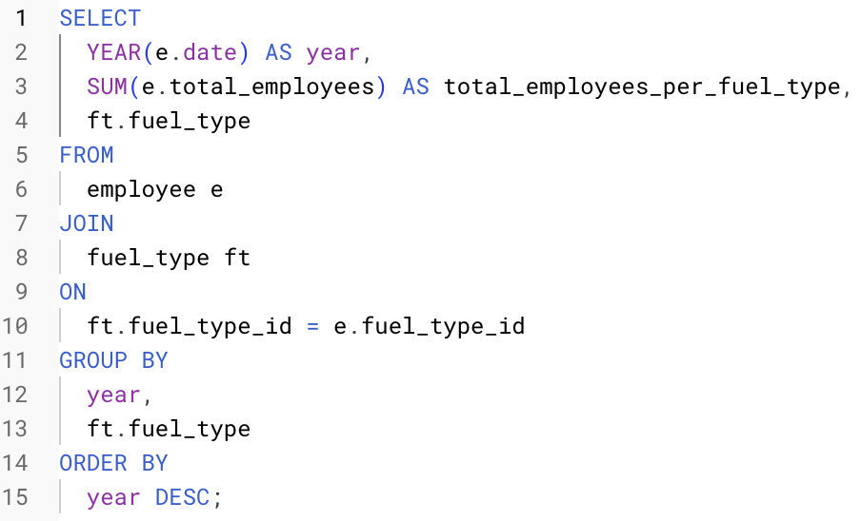
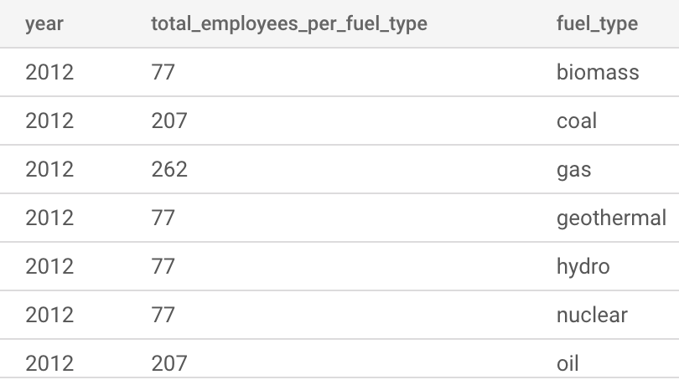
SQL Query 3:
Economic Impact by Fuel Type
Analyze the economic contribution of power plants by fuel type in terms of employment.
Identify the fuel types generating the most employment
Code: | Output:
Notes:
SELECT
YEAR(e.date) AS year,
SUM(e.total_employees) AS total_employees_per_fuel_type,
ft.fuel_type
FROM
employee e
JOIN
fuel_type ft
ON
ft.fuel_type_id = e.fuel_type_id
GROUP BY
year,
ft.fuel_type
ORDER BY
year DESC;

Slide 17
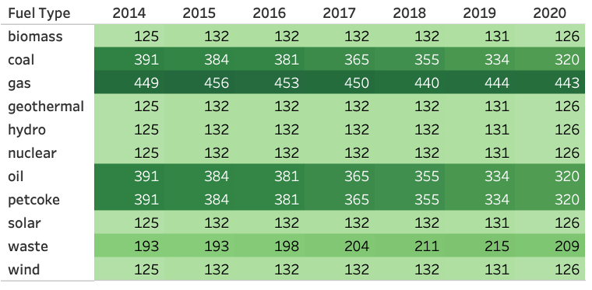
Report Query 3:
Economic Impact by Fuel Type
Yearly Total Employee Per Energy Fuel Type
Top Employment Trends:
Gas consistently employs 2-3 times more workers than other fuel types.
Oil, coal, and petcoke have seen an 18.15% decline in employees over the past 6 years.
Employment in all renewable energy fuel types has remained stagnant over the same period.

Slide 18
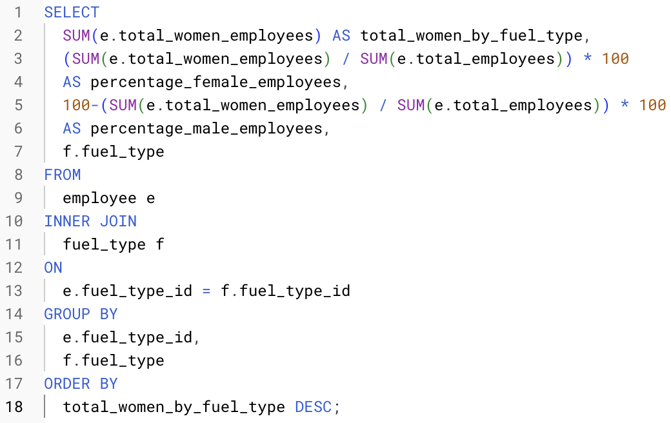
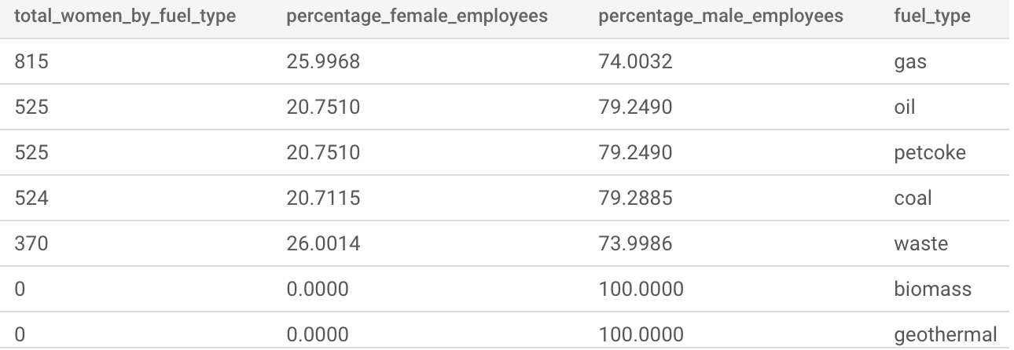
SQL Query 4:
Economic Impact by Fuel Type - Gender Gap
Examine women representation in total employees across different energy fuel types
Highlight gender disparities and promote discussions on improving women's representation in the sector.
Code: | Output:
cc
Notes:
SELECT
SUM(e.total_women_employees) AS total_women_by_fuel_type,
(SUM(e.total_women_employees) / SUM(e.total_employees)) * 100
AS percentage_female_employees,
100-(SUM(e.total_women_employees) / SUM(e.total_employees)) * 100
AS percentage_male_employees,
f.fuel_type
FROM
employee e
INNER JOIN
fuel_type f
ON
e.fuel_type_id = f.fuel_type_id
GROUP BY
e.fuel_type_id,
f.fuel_type
ORDER BY
total_women_by_fuel_type DESC;

Slide 19
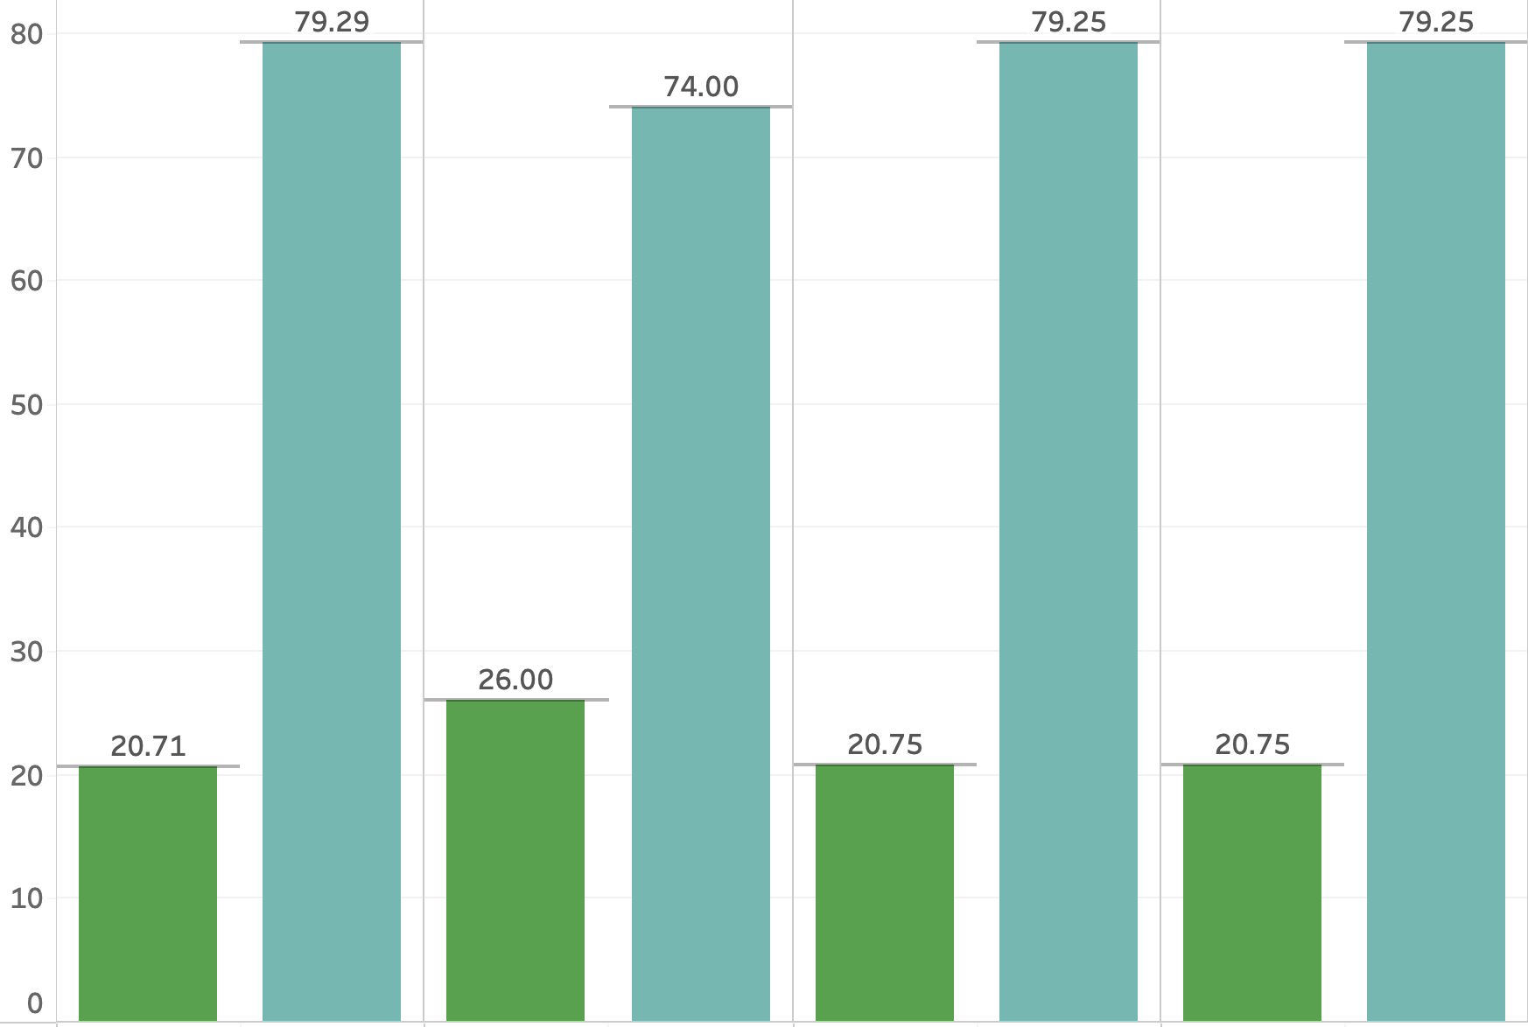
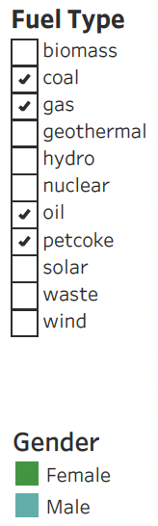
Report Query 4:
Economic Impact for Non-Renewable Energy - Gender Gap
Gender Comparison - Employment by Energy Source
(Fuel Type)
Insights:
Significant gender gap, with men dominating the field, hinting at systemic issues in recruiting or retaining female employees.
In coal, oil, and petcoke sectors, female employment is below 21%, indicating significant gender disparity.
Near-equal distribution in the aggregate of all power plants.
Percentage of Employees (%)
Coal
Gas
Oil
Petcoke

Slide 20
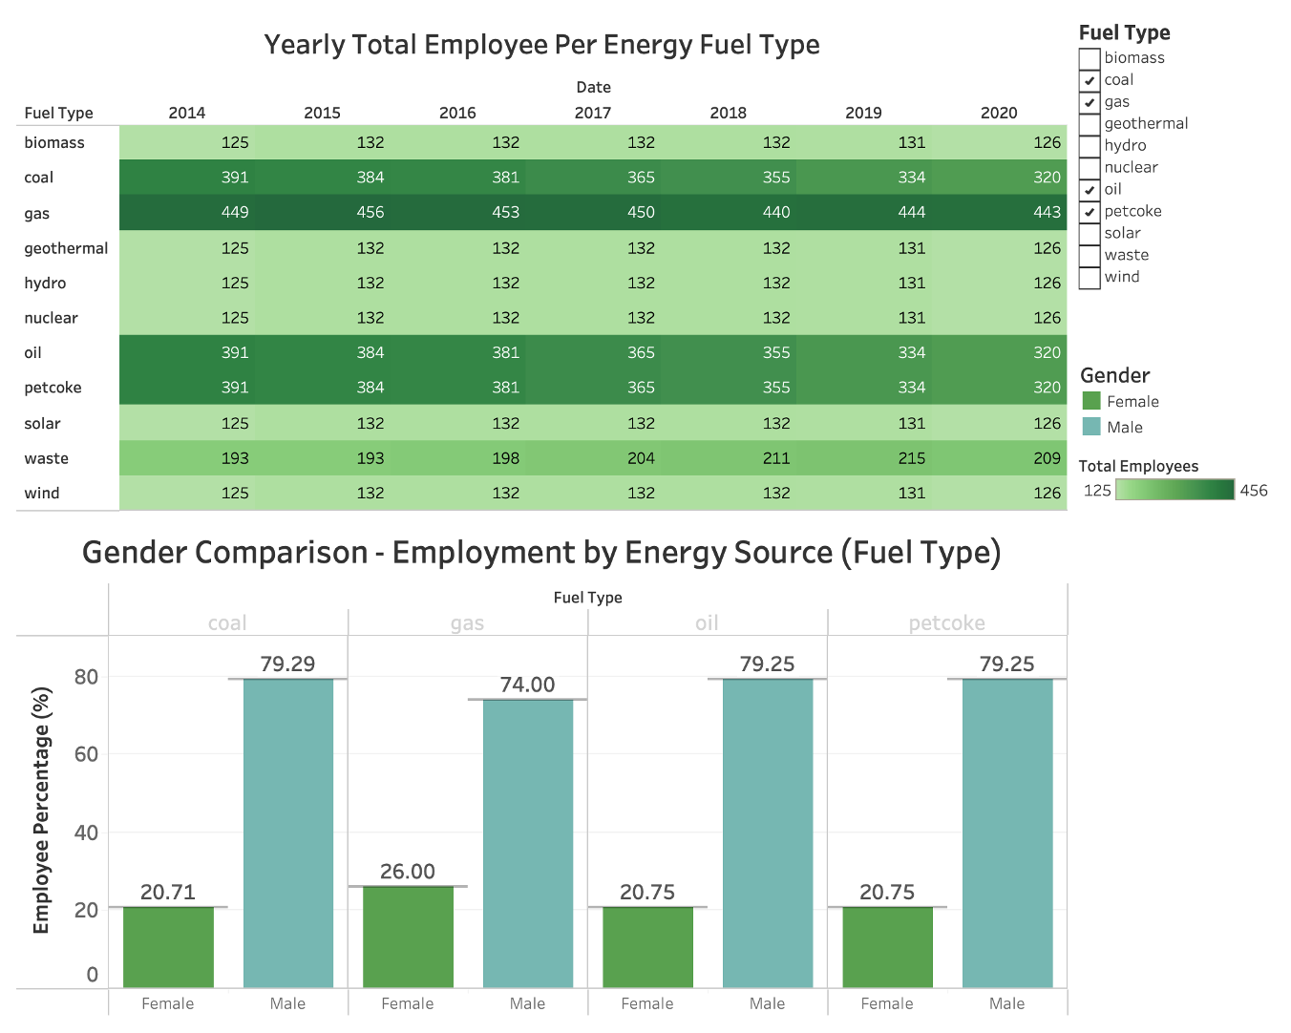
Dashboard
Employment Trend
Top Insights:
Gas consistently employs 2-3 times more workers than other fuel types.
Significant gender gap, with men dominating the field
Notes:
Halle

Slide 21
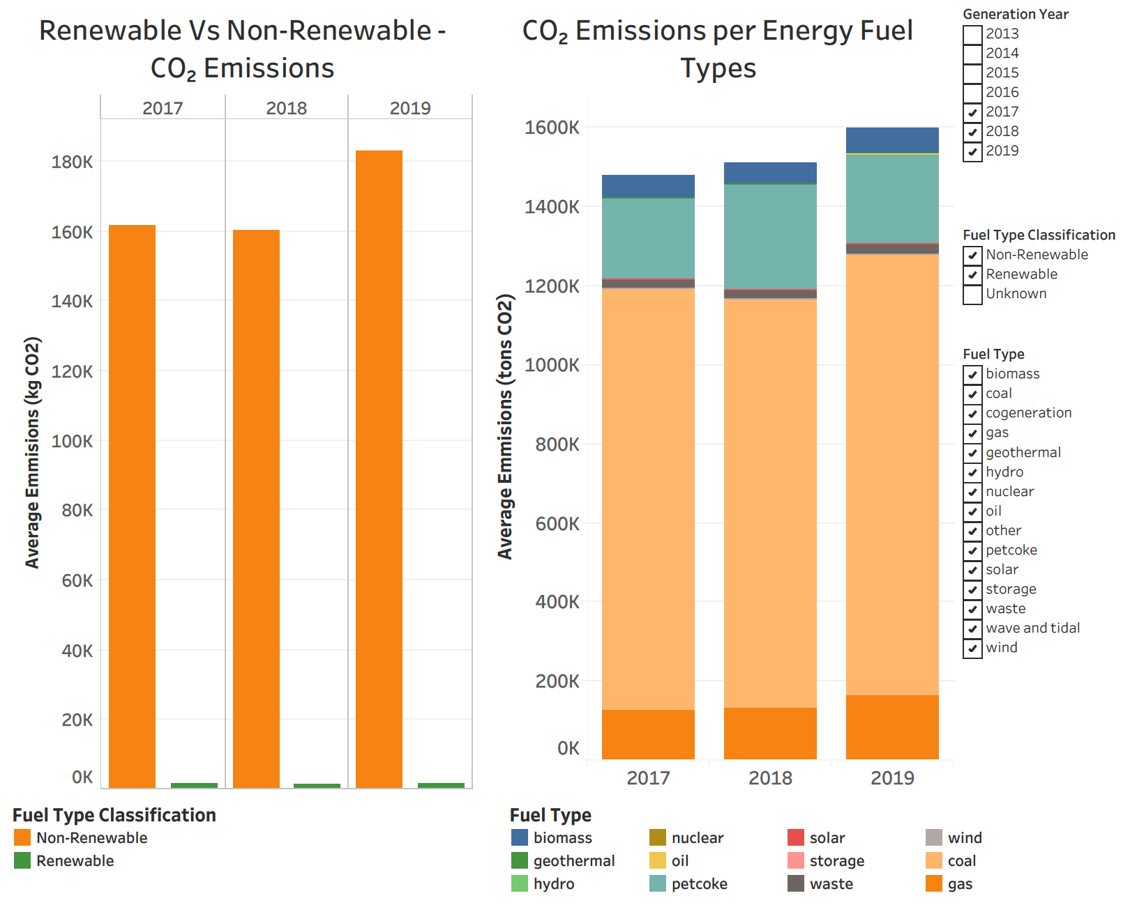
Dashboard
CO₂ Emission Trend
Top Insights:
Non-renewable Fuels significantly dominate the CO₂ emissions.
Coal and Gas contribute the majority of the CO2 emissions
Notes:
Halle

Slide 22

Recommendations
Identifying Renewable Energy Hotspots:
Identified hotspot countries indicate potential opportunities for further investment
Hotspot countries can assist untapped countries in implementing renewable energy sources
Energy Generation Performance Monitoring:
Improve Forecasting Accuracy
Enhance Operational Efficiency
Develop Real-Time Monitoring Systems
Regional Economic Impact by Fuel Type:
Expand workforce training and development in renewable energy sectors.
Boost investment and innovation to attract talent to renewables.
Strengthen industry-education partnerships to build a skilled workforce.
Economic Impact by Fuel Type - Gender Gap:
Boost women workforce in non renewable fuel type power plants.
Promote Gender Diversity in Renewable Energy.
Awareness Campaigns to Reduce Stereotypes.
Notes:
Veera, Bruna and Hritik

Slide 23

Lessons Learned
Women are still under represented in employment
Providing Context: Paris Agreement (Treaty) 2016: United States and China main contributors.
United States joined in 2016, exited 2017-2020 and rejoined in 2021 (might withdraw in 2025). State-level initiatives also may impact USA's contribution.
China is an emerging leader during United States’s shifting positions
Hydro is still most popular within renewable energy sources for efficiency and cost.
Gas remains dominant in the employment sector, highlighting its continued importance in the energy mix.
Employment data suggests that there has not been an increase in the number of plants generating renewable energy.
Stagnation in renewables emphasizes the importance of innovation and strategic investment to drive growth.

Slide 24
Questions?

